Slide 1
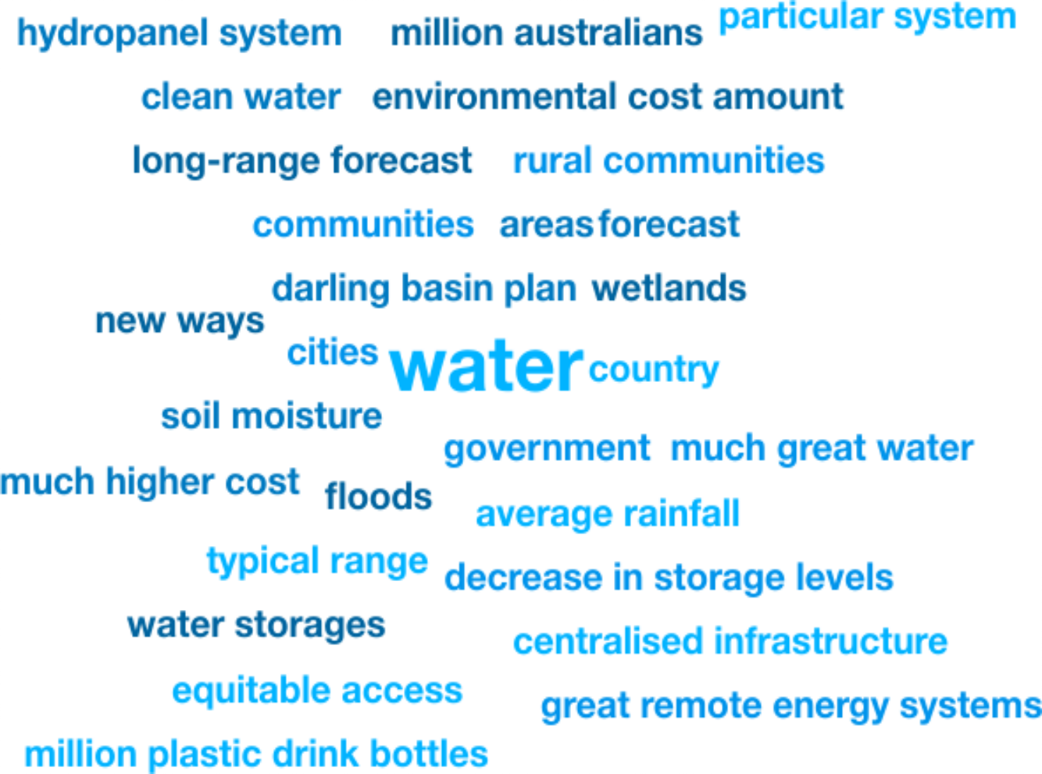

Weekly Media Report
Top Keywords
Nov 2 - Nov 8

Slide 2
Total Mentions
Nov 2 - Nov 8
Total Reach
Nov 2 - Nov 8
Total Potential Editorial Reach
Nov 2 - Nov 8
21
339k
14.4M
Mentions
Reach
Reach
News Engagement
Nov 2 - Nov 8
TV Engagement
Nov 2 - Nov 8
Social Engagement
Nov 2 - Nov 8
Radio Engagement
Nov 2 - Nov 8
14
5
2
0
Mentions
Mentions
Mentions
Mentions

Slide 3


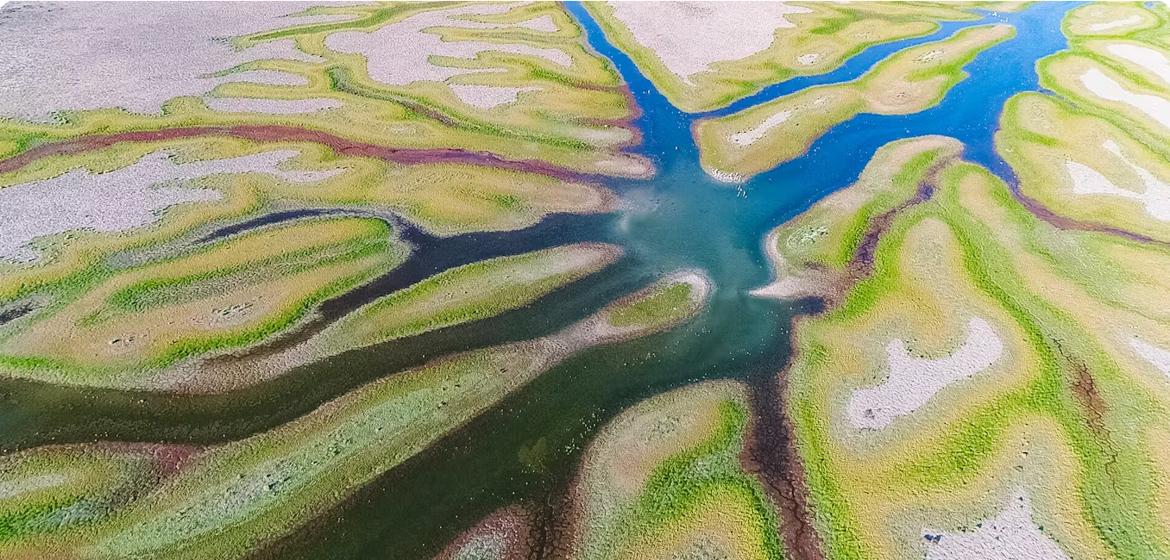
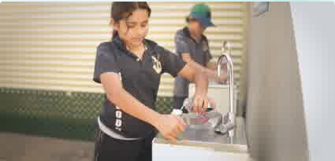







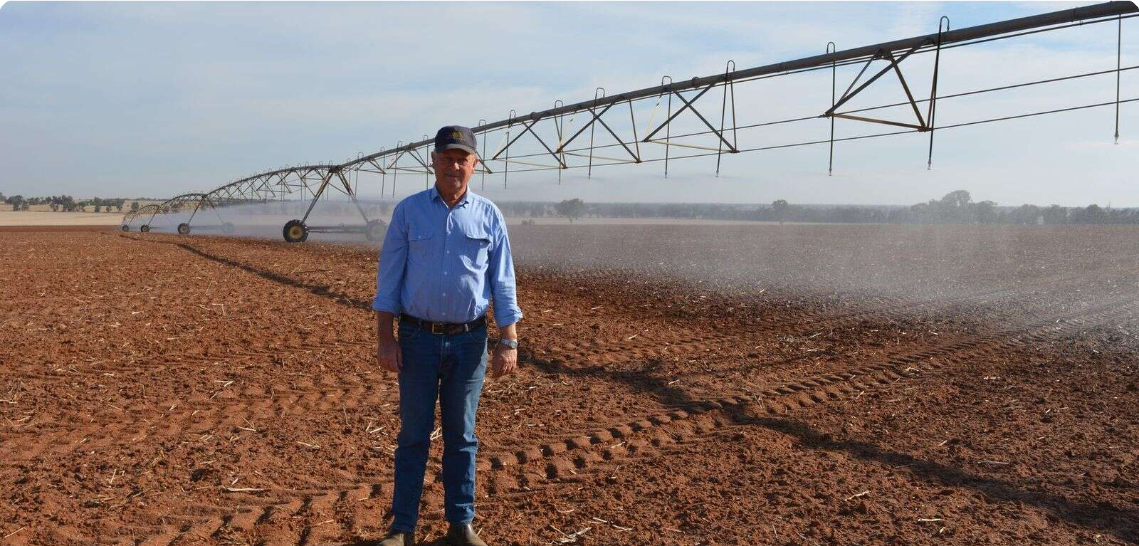
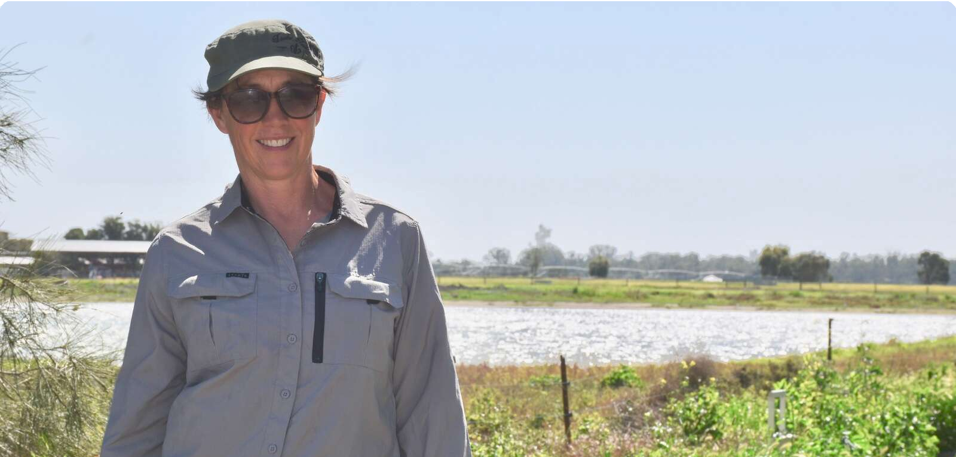
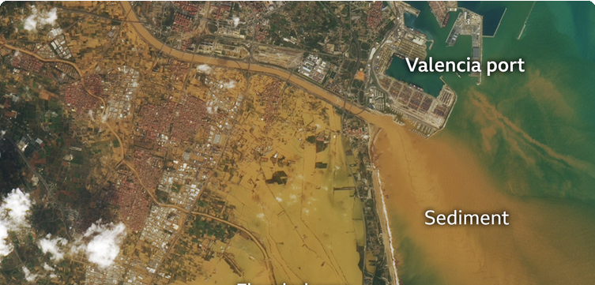
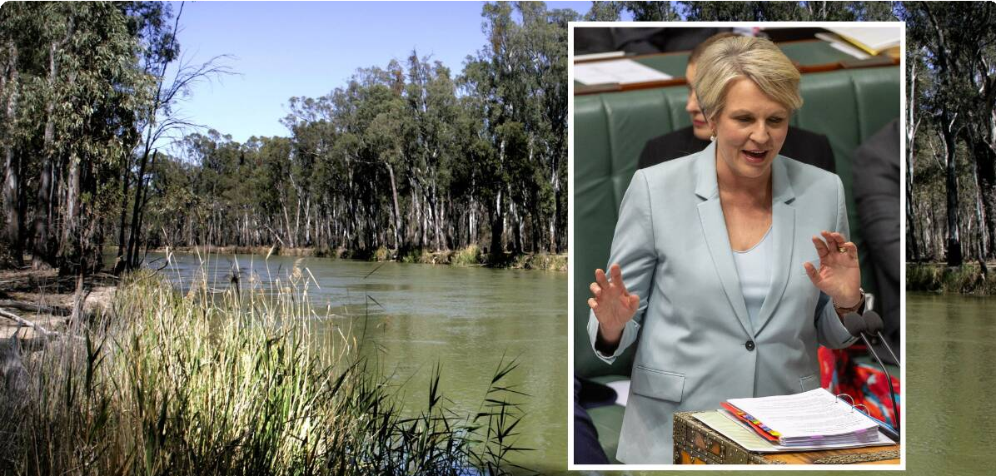



Highest news articles
N
N
News.com.au (Licensed by Copyright Agency)
News | AU | Nov 6 · 7:49 AM
T
The Weekly Times (Licensed by • Pete… Copyright Agency)
News | AU | today · 9:34 AM
The Border Mail (Licensed by Copyright Agency)
News | AU | Nov 6 · 1:00 PM
Andre…
The Conversation (Licensed by • Jan K… Copyright Agency)
News | AU | Nov 4 · 2:07 PM
Dams have taken half the water from Australia’s second biggest river – and
A
ABC1 Melbourne
TV | AU | Nov 3 · 1:20 PM
Climate change exacerbates impact of ﬂow regulation for Australias rivers
Plibersek’s 70GL water tender: More than 1000 irrigators lodge offers
Farmers slam MDBA ﬂooding study as an absolute sham
Landline
of the south and east. Combined, water storages
12.9M Reach 0 Social Echo
169k Reach 6 Social Echo
121k Reach 0 Social Echo
96.8k Reach 182 Social Echo
94.9k Reach
The Shepparton News (Licensed by Copyright Agency) News | AU | today · 3:22 PM
Geoﬀ…
The Shepparton News (Licensed by Copyright Agency)
News | AU | Nov 6 · 9:22 AM
Increased ﬂood risk fears
Cont…
The Shepparton News • Sophi… (Licensed by Copyright
Agency)
News | AU | yesterday · 3:47 PM
Wetlands dream takes shape
Jodie Hay is a ﬁrm believer irrigation is dual-
59.6k Reach 0 Social Echo
Cairns • View all posts by Editor, cai… News
News | AU | Nov 5 · 1:04 PM
The Queensland Country • Chris McLe… Life
News | AU | today · 11:00 AM
Basin buyback bonanza as Govt ﬂooded with offers to sell irrigation water
Riverina ﬁgures in water body changes
... National Irrigators’ Councils newly elected
60.3k Reach 0 Social Echo
Hydrology or ideology? Flood ‘fact- checkers’ need to dig deeper
... for those aﬀected by any proposed changes to
59.6k Reach 0 Social Echo
33.5k Reach 2 Social Echo
17.8k Reach 0 Social Echo

Slide 4
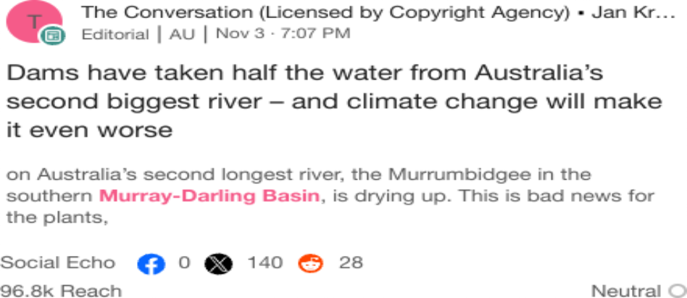
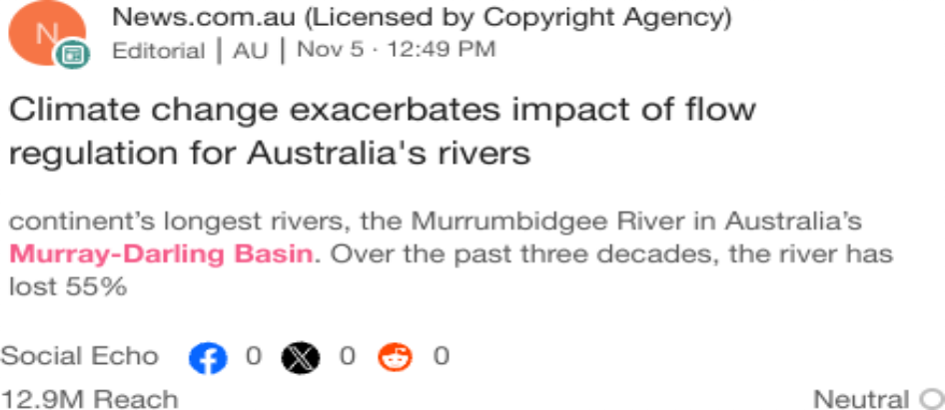
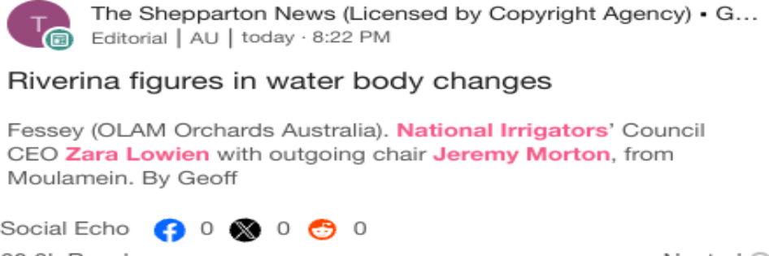
Highlighted Industry and NIC
Most Social Shares
Nov 2 - Nov 8
Highest Potential Editorial Reach
Nov 2 - Nov 8
Highest Syndication
Nov 2 - Nov 8
Mentions Trend
Nov 2 - Nov 8
Share of Voice by Source Type
Nov 2 - Nov 8
Top Publications and Share of Voice
Nov 2 - Nov 8
40
100%
The Shepparton News (…
30
2WEB - Outback Radio
Mentions
Mentions
ABC Broken Hill AM
20
50%
The Riverine Herald (Lic…
10
Seymour Telegraph (Lic…
0%
1
2
3
Mentions
4
5
6
Nov 2
Nov 3
Nov 4
Nov 5
Nov 6
Nov 7 No…
News
Broadcast
X
National Irrigators
Industry - News
National Irrigators
Industry - News
National Irrigators
Industry - News

