Slide 1
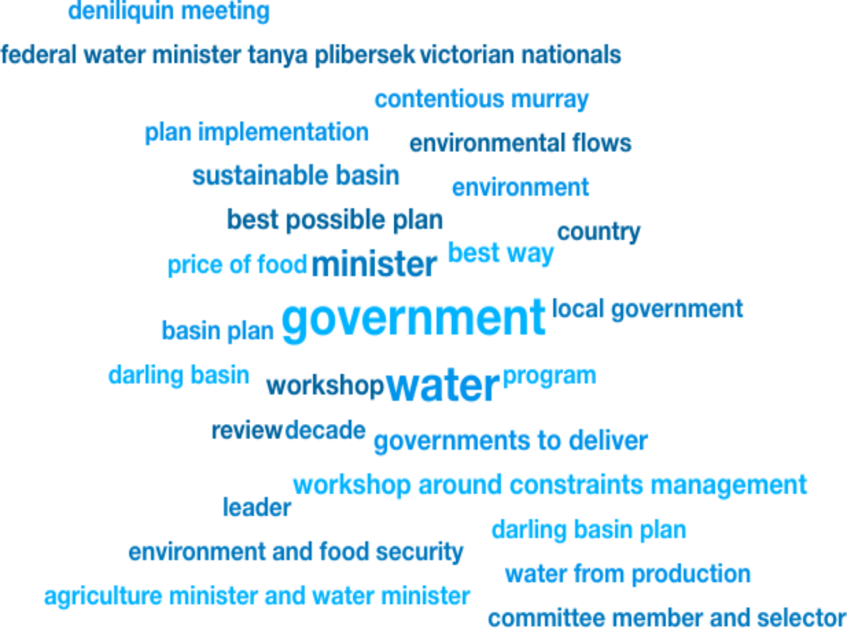

Weekly Media Report
Top Keywords
Nov 23 - Nov 29

Slide 2
Total Mentions
Nov 23 - Nov 29
Total Reach
Nov 23 - Nov 29
Total Potential Editorial Reach
Nov 23 - Nov 29
19
331k
18.6M
Mentions
Reach
Reach
News Engagement
Nov 23 - Nov 29
TV Engagement
Nov 23 - Nov 29
Social Engagement
Nov 23 - Nov 29
Radio Engagement
Nov 23 - Nov 29
9
0
0
10
Mentions
Mentions
Mentions
Mentions

Slide 3

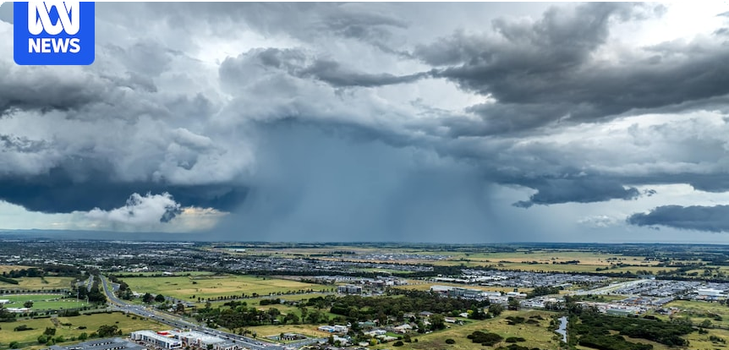


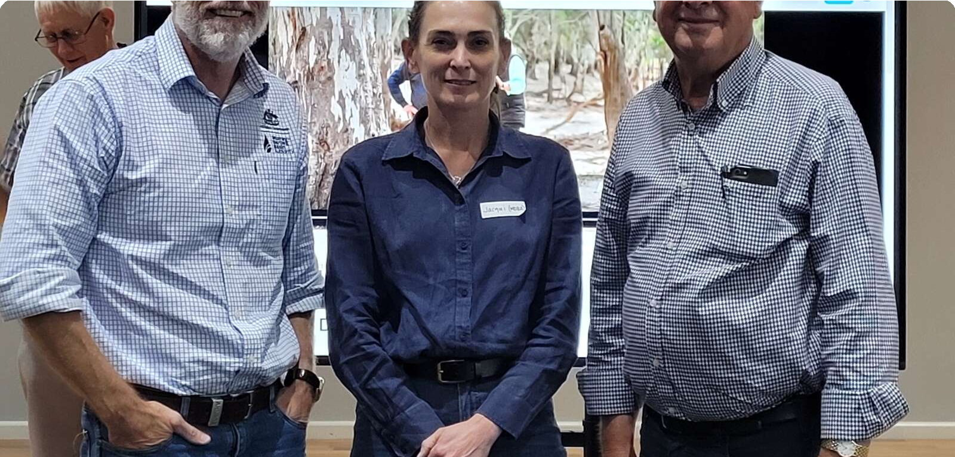
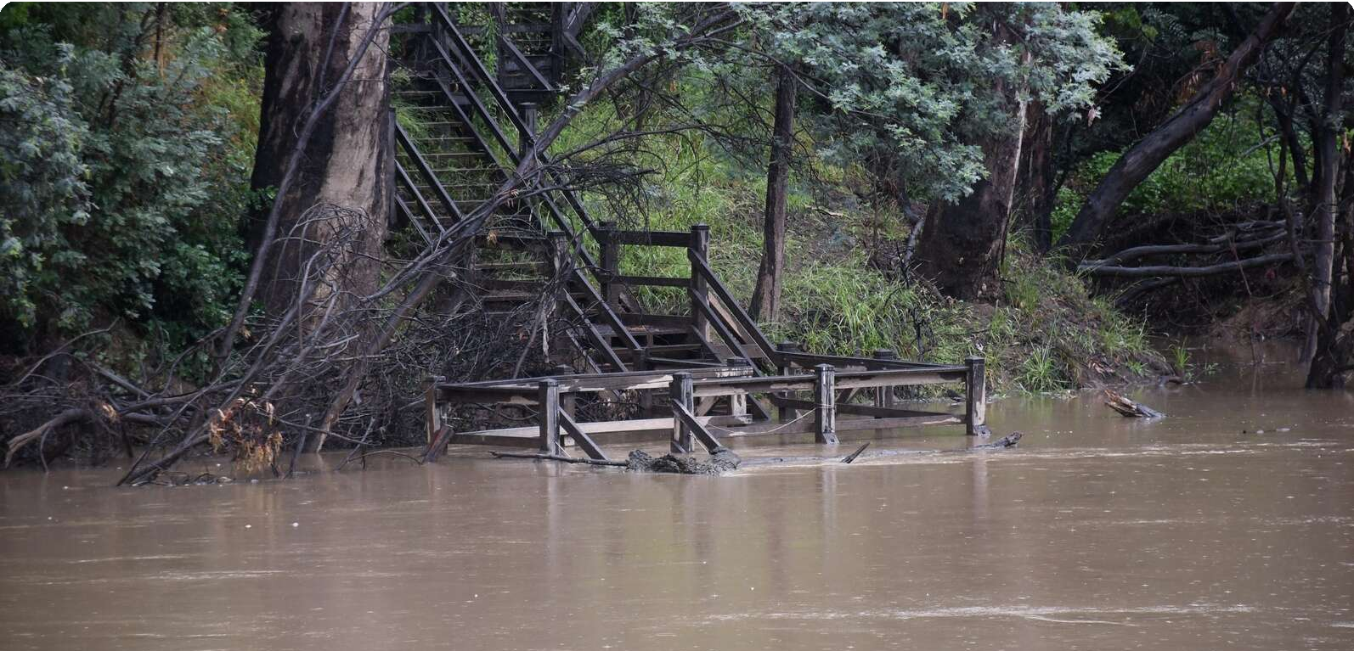





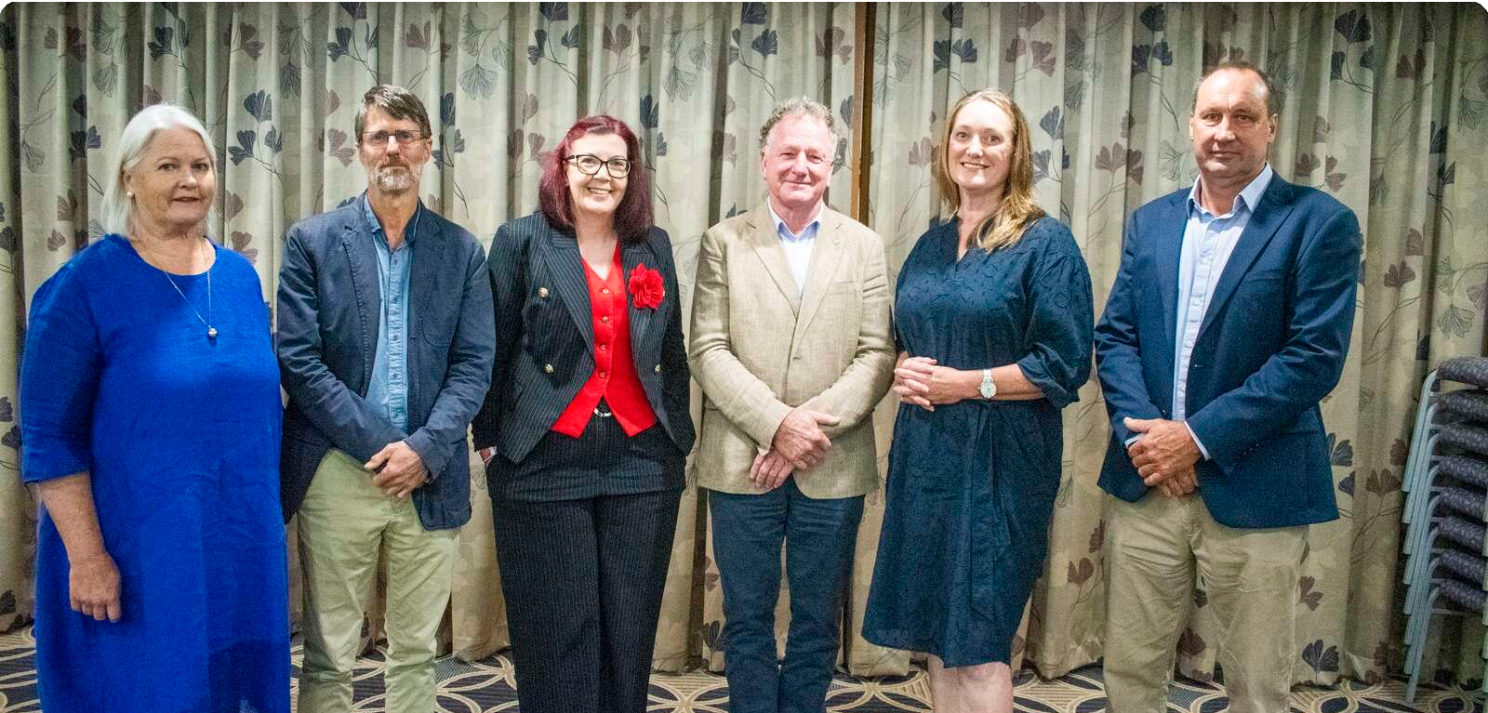
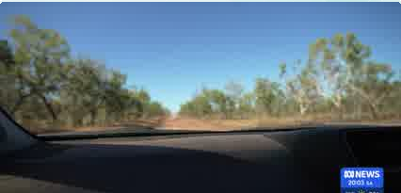



Highest news articles
ABC Online (Licensed by • Tom Sa… Copyright Agency)
News | AU | yesterday · 5:52 AM
T
The Australian • Tricia Rivera
News | AU | Nov 26 · 5:48 PM
MacroBusiness • Leith van Onselen
News | AU | Nov 26 · 10:00 AM
The Shepparton News • Geoﬀ… (Licensed by Copyright Agency)
News | AU | yesterday · 11:21 AM
The Shepparton News (Licensed by Copyright Agency) News | AU | today · 8:18 AM
Geoﬀ…
Eastern Australia faces multi-day thunderstorm outbreak with ﬂash
No change to treaty position under new Nationals leader Danny O’Brien
Water planning 101: Stabilise Australia’s population
Water group encouraged by MDBA talk
... group has been encouraged by its latest
Easement, not land purchase, says NSW
... as the Reconnecting River Country Program is a
14.4M Reach 42 Social Echo
2.2M Reach 0 Social Echo
1.04M Reach 24 Social Echo
60.3k Reach 0 Social Echo
60.3k Reach 0 Social Echo
The Shepparton News (Licensed by Copyright Agency) News | AU | today · 8:18 AM
Zoe …
InsideWater • Tanya Plibersek
News | AU | Nov 27 · 8:03 AM
A
ABC 24
TV | AU | Nov 23 · 8:33 PM
Pay cap, director appointments approved
... as deputy chair, and Mrs Coupland was elected
Tanya Plibersek on water in Australia
... Irrigation Network in Victoria, Bunbury in
1.8k Reach 1 Social Echo
Four Corners
. KIRSTY HOWEY: Weve also seen the creation of
60.3k Reach 0 Social Echo
0 Reach

Slide 4
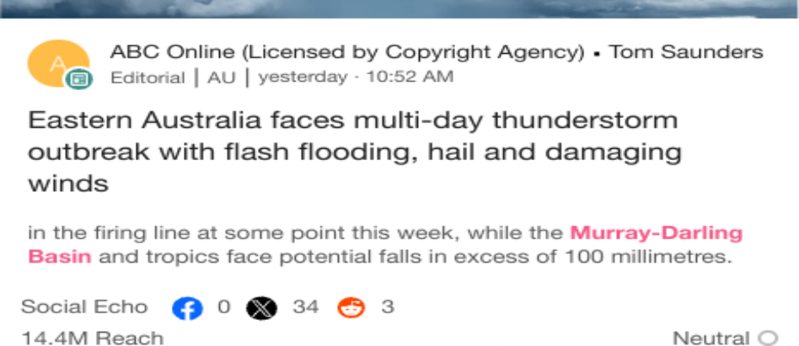

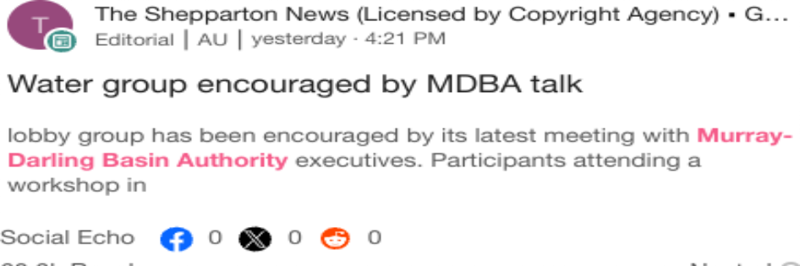
Highlighted Industry and NIC
Most Social Shares
Nov 23 - Nov 29
Highest Potential Editorial Reach
Nov 23 - Nov 29
Highest Syndication
Nov 23 - Nov 29
Mentions Trend
Nov 23 - Nov 29
Share of Voice by Source Type
Nov 23 - Nov 29
Top Publications and Share of Voice
Nov 23 - Nov 29
40
100%
The Shepparton News (…
The Riverine Herald (Lic…
Mentions
Mentions
Seymour Telegraph (Lic…
Cobram Courier (Licensed by Copyright Agency)
The Campaspe News (L…
20
50%
0%
1
2
3
4 5 6
Mentions
7
8
Nov 23
Nov 24
Nov 25 Nov 26
Nov 27
Nov 28 No…
Broadcast
News
X
National Irrigators
Industry - News
National Irrigators
Industry - News
National Irrigators
Industry - News

