Slide 1
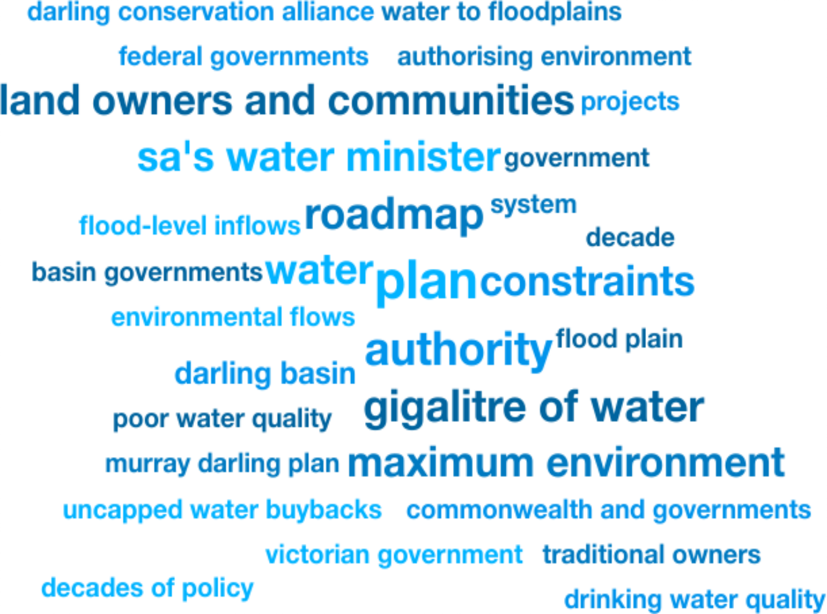
Weekly Media Report
Top Keywords
Dec 13 - Dec 19

Slide 2
Total Mentions
Dec 13 - Dec 19
Total Reach
Dec 13 - Dec 19
Total Potential Editorial Reach
Dec 13 - Dec 19
3
149k
45.7M
Mentions
Reach
Reach
News Engagement
Dec 13 - Dec 19
TV Engagement
Dec 13 - Dec 19
Social Engagement
Dec 13 - Dec 19
Radio Engagement
Dec 13 - Dec 19
1
0
2
0
Mentions
Mentions
Mentions
Mentions

Slide 3
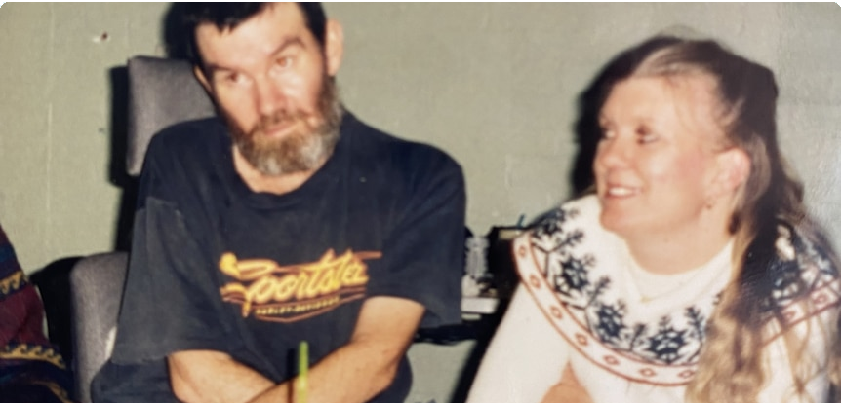
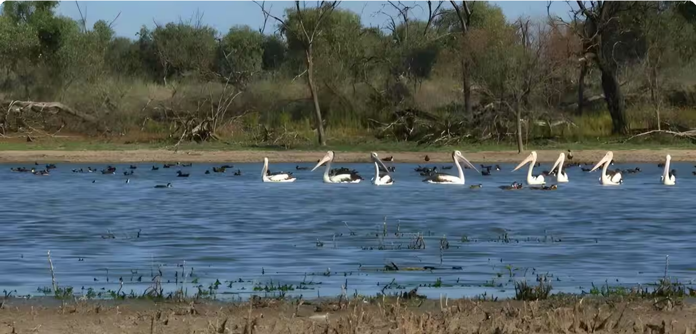
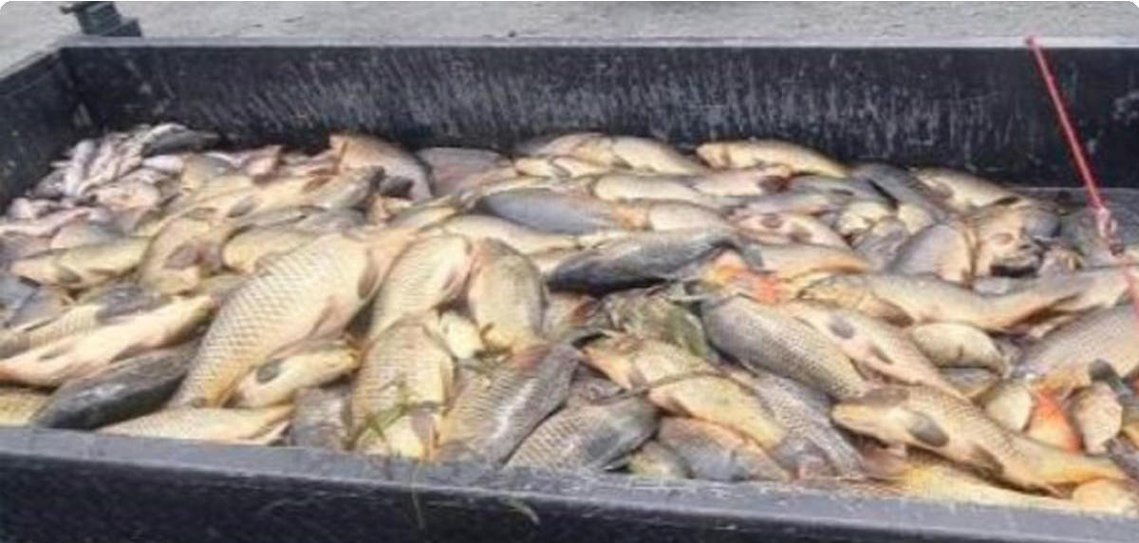
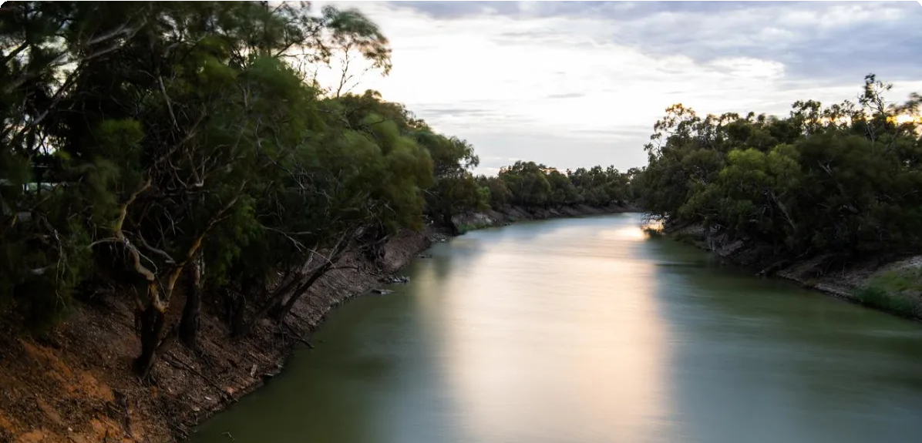
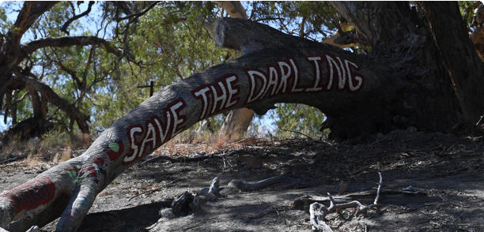
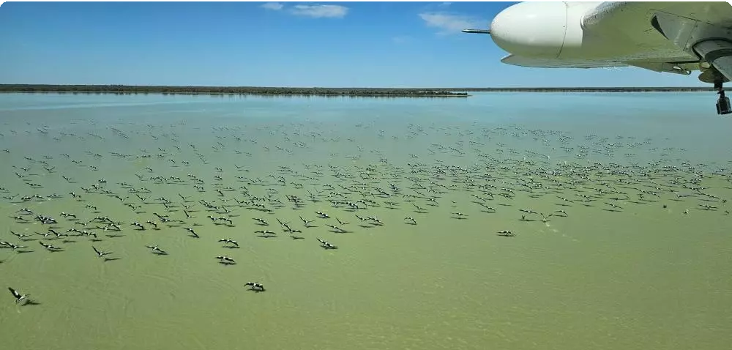
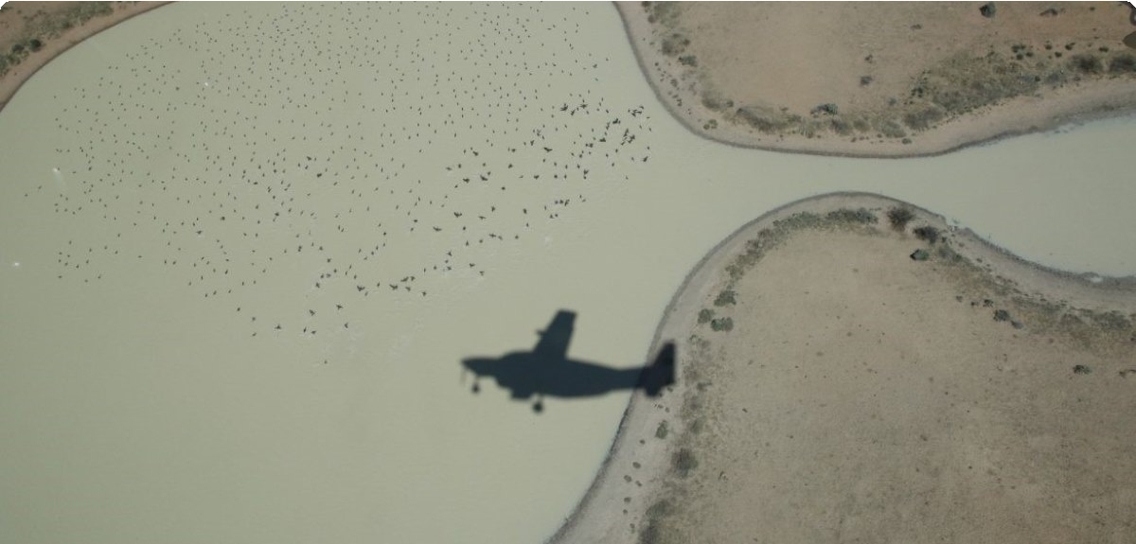
Highest news articles
N
ABC Online (Licensed by Copyright Agency)
News | AU | Dec 14 · 5:02 AM
Fleur C…
News.com.au (Licensed by Copyright Agency)
News | AU | Dec 17 · 9:19 AM
SBS TV (Licensed by Copyright Agency)
News | AU | Dec 14 · 2:51 PM
Sydney…
Yahoo News Australia (Licensed by Copyright Agency)
News | AU | Dec 13 · 5:14 PM
Courtn…
Yahoo News Australia (Licensed • Adria… by Copyright Agency)
News | AU | Dec 18 · 6:00 AM
N
Y
Y
Program: Investigating the environmental triggers for motor neurone disease
Waterbird numbers down almost 50% after drier 2024: aerial survey
Heart of Australia - the Murray Darling Basin - is in declining health
Trailer full of ﬁsh exposes disturbing reality in Aussie waterways
Balancing needs key challenge of Murray Darling plan
15.1M Reach 2 Social Echo
12.6M Reach 0 Social Echo
3.42M Reach 0 Social Echo
1.51M Reach 1 Social Echo
1.51M Reach 0 Social Echo
M
MSN Australia • Adrian Black
News | AU | Dec 18 · 5:56 PM
M
MSN Australia • Will Hunter
News | AU | Dec 13 · 8:54 AM
inkl • Donna Lu
News | AU | Dec 17 · 2:40 AM
Cosmos Magazine (Licensed by Copyright Agency)
News | AU | Dec 17 · 1:12 PM
Imma …
7
7 Sydney
TV | AU | Dec 15 · 6:31 PM
Mission to save Murray-Darling Basin edges forward
Grape growers in Australias largest wine region plead for change at senate inquiry
Waterbird populations plunge dramatically as eastern Australia dries up
Waterbird numbers almost halved after drier 2024
Channel Seven News
the way to raise money to keep it that way. 4 ,000
1.25M Reach 0 Social Echo
1.25M Reach 0 Social Echo
575k Reach 0 Social Echo
389k Reach 4 Social Echo
238k Reach

Slide 4
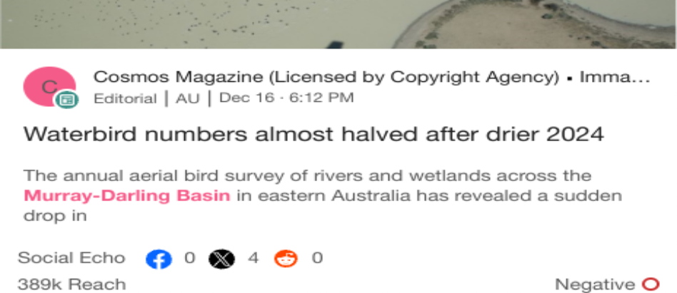
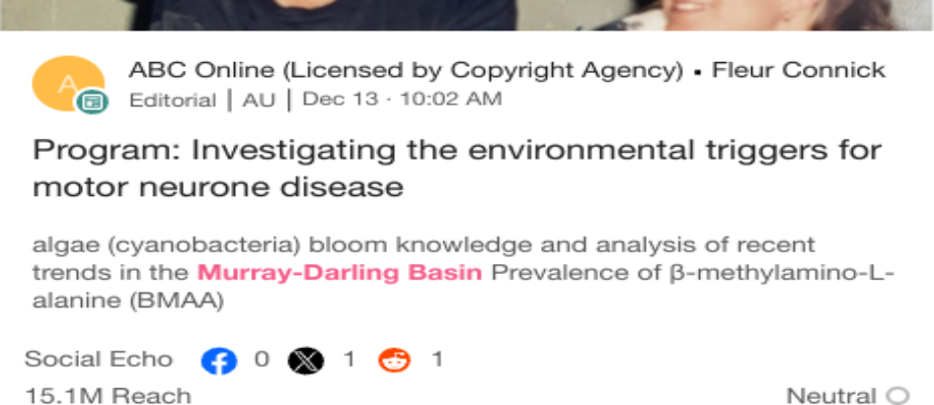
Highlighted Industry and NIC
Most Social Shares
Dec 13 - Dec 19
Highest Potential Editorial Reach
Dec 13 - Dec 19
Highest Syndication
Dec 13 - Dec 19
Mentions Trend
Dec 13 - Dec 19
Share of Voice by Source Type
Dec 13 - Dec 19
Top Publications and Share of Voice
Dec 13 - Dec 19
300
100%
ABC Broken Hill AM
The Shepparton News (…
Mentions
200
Mentions
50%
The Riverine Herald (Lic…
100
Seymour Telegraph (Lic…
Cobram Courier (Licensed by Copyright Agency)
0%
2
4
6
Mentions
8
10
12
Dec 13
Dec 14
Dec 15 Dec 16
Dec 17
Dec 18 De…
X
News
Broadcast
National Irrigators
Industry - News
National Irrigators
Industry - News
National Irrigators
Industry - News

