Slide 1


Basin Plan Review Q&A
10 February 2026

Slide 2

Purpose of BPR Q&A
Regular quick catch up
Keep NIC and Members informed on events
Pose questions, track issues
  Detailed discussion in Policy Sessions on Wednesday’s

Slide 3
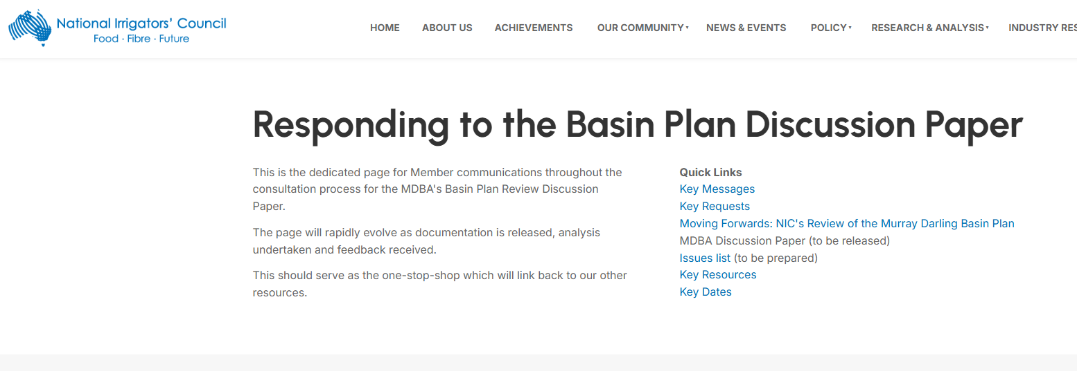
MDBA Launch & Consultations
Basin Plan Review Discussion Paper
Initial SDL Assessment Report
Menindee Technical Report – launched today
Webinars – Menindee Thursday 12th, Initial SDL Assessment Friday 13th
Irrigation Roundtables – 16th February
Member WEBSITE

Slide 4
In preparation for next week
Detailed brief
  Gap analysis
  Key issues
  Discussion points for NIC members
Updated key messages

Slide 5

Initial thoughts concerns

Slide 6

0427 521 399

