Slide 1
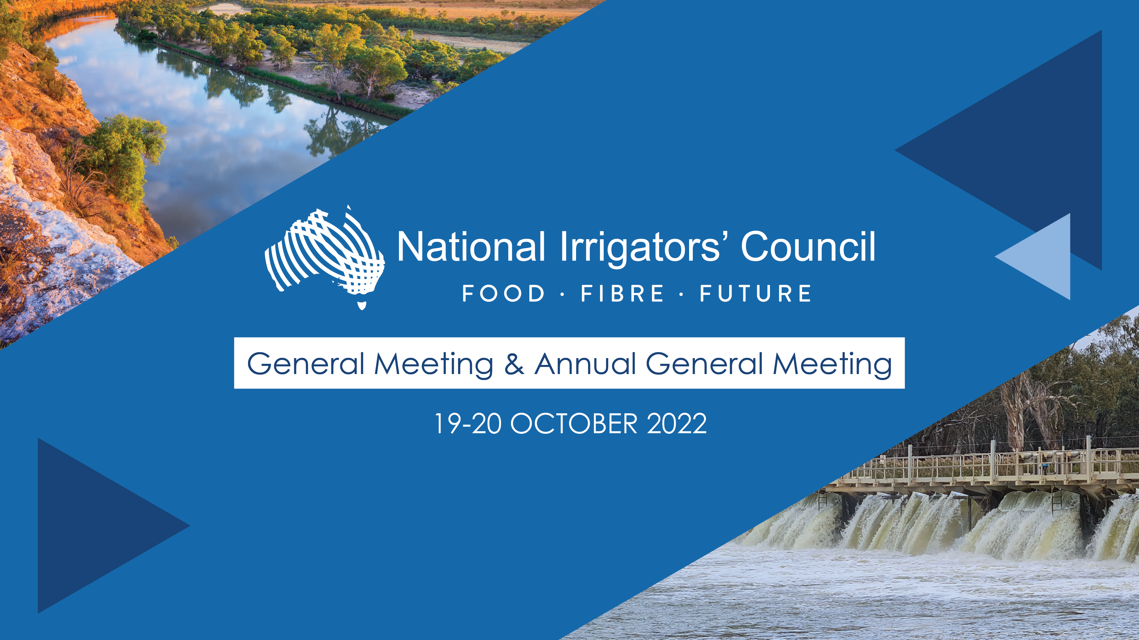

Policy Discussion Workshop
11 February 2026

Slide 2

Today’s Session
IGWC
Basin Plan Discussion paper – key gaps and issues
General business

Slide 3
IGWC Review
Statutory review
Key issues:
Support intent of the role (separate functions for policy development, implementation and enforcement/compliance
Issues of duplication / inefficiency (e.g. SDL compliance assessment process)
Question ‘tough cop’ role within constitutional framework
Question if proportionate – i.e. role commenced in response to water ‘mismanagement’ – is this occurring to the extent anticipated?
Concerns re politicization
Confusion of role – e.g. compliance of water users vs of agencies and jurisdictions
Query independence

Slide 4
Basin Plan Discussion Paper
Discussion Paper
Initial SDL Assessments
SDL Assessment Framework
Menindee Technical Report
Menindee Issues Paper

Slide 5
Basin Plan Discussion Paper
Proposes a shift from water recover (although not entirely ruled out) to addressing other drivers.
Focuses on connectivity – within river (northern basin), onto floodplains (southern basin and the Gwydir) meaning two key focuses is the timing of water deliver and constraints – these largely to address areas of concern with three catchment where they are unsure if the SDL = ESLT.
Does not provide any discussion on challenges for SA Murray and the Coroong, despite the question on ESLT being achieved.
Attempts to consider water quality and critical human needs. However, does not have the current legislative levers.
Makes little suggestions on how to incorporate NRM into Basin Planning.
Makes some reasonable suggestions for streamlining planning and reporting, and WRPs.
Look at Chapter 12 – includes all the proposals and options for Basin Plan 2.0

Slide 6
Basin Plan Discussion Paper Assumptions
The MDBA assessed water sources to determine if water use was a ecological sustainable level of take, they considered three scenarios:
Implementation to June 2024 (retrospective);
Full implementation with the assumption of full 450GL purchased (100 GL from the northern basin) and 300 GL of a SDLAM shortfall recovered but no further constraints (retrospective).
Plausible future climate scenario (forward looking).
Full implementation with the assumption of full 450GL purchased (100 GL from the northern basin) and 300 GL of a SDLAM shortfall recovered
ESLT = Basin Plan + 450GL

Slide 7
Initial SDL Assessment
Three catchments where SDL is unsure – further work is required, however there was no detail on the drivers or discussion for Basin Plan 2.0 for the SA Murray and Coorong.
More catchment are to be monitored, which are the larger ones and two groundwater.
SDL unit | SDL = ESLT | Environmental outcome risks | Drivers
Barwon-Darling | Unable to determine, further work required | Ecosystem function and native fish | Pattern of flow is the likely leading driver of risk
Condamine-Balonne | Confident | Not at risk
Gwydir | Likely | Waterbirds | Pattern of flow
Intersecting Streams | Confident | Not at risk
Lachlan | Confident | Not at risk
Macquarie-Castlereagh | Confident | Not at risk
Murrumbidgee | Likely | Native fish, flows and connectivity, and native vegetation | Pattern of flow

Slide 8
Initial SDL Assessment
Namoi | Confident | Not at risk
NSW Murray | Likely | Flows and connectivity, ecosystem functions and native fish | Pattern of flow
Lower-Darling | Unable to determine, further work required | Flows and connectivity, ecosystem function and native fish | Pattern of flow
SA River Murray | Unable to determine, further work required | Flows and connectivity, ecosystem functions, native fish and waterbird | Pattern of flow (due to constraints) likely, sufficiency of flow also potential factor.
SA Murray Region | Confident | Not at risk
QLD Border Rivers | Confident | Not at risk
Moonie | Confident | Not at risk
Eastern Mount Lofty Ranges | Confident | Not at risk
Marne Saunders | Confident | Not at risk
Warrego | Confident | Not at risk
Nebine | Confident | Not at risk
Paroo | Confident | Not at risk
ACT | Confident | Not at risk
Vic Murray | Likely | Flows and connectivity, ecosystem functions and native fish | Pattern of flow (due to inability to deliver water onto floodplains)

Slide 9
Initial SDL Assessment
Kiewa | Confident | Not at risk
Northern Vic Murray
Ovens | Confident | Not at risk
Broken | Confident | Not at risk
Goulburn | Likely | Flows and connectivity, ecosystem functions and native vegetation | Pattern of flow (inability to deliver higher in-channel flows and water to the floodplain in the lower Goulburn River)
Campaspe | Confident | Not at risk
Loddon | Confident | Not at risk
Wimmera–Mallee | Confident | Not at risk

Slide 10
Gaps
SDL assessment assumptions of recovery and SDLAM.
Of the three catchments where SDL is unsure – further work is required, however there was no detail on the drivers or discussion for Basin Plan 2.0 for the SA Murray and Coorong.
SDL performance (under usage) not discussed, or whether SDL is too low.
No discussion on how to recover water under the assumed scenario, what are the costs and benefits of this versus other options.
Connectivity challenges – mixed messages, between DCCEEW and MDBA, detail with NSW Gov.
Menindee lakes, discussion is a separate consultation although simultaneous.
Lack of regulatory levers for the MDBA at current – no suggestion of changes.
Risk of water from agriculture being used for critical human needs planning.
Infrastructure details and risks.
Alarmingly, there was no discussion the costs and benefits of options and not enough information to inform this as part of the discussion paper – this leads to the key question of priorities.

Slide 11
Next steps & Discussion
Update key messages prior to the Roundtables.
Consider – calling for more information to assess the costs and benefits of options, in lines with Audit Office requirements for regulatory impact assessments – this would help inform prioritisation
Consider – calling for another step on consultation to discuss the benefits of options, once the above is known
Work on infrastructure gaps
Continue to work on prioritisation as part of Oz Water paper
Work on further evidence on SDL has achieved its goal with more explicit evidence of no need for full implementation scenario

Slide 12
Basin Plan Review Strategy – what we are asking for
No more water from agriculture (by any means)
Future Basin Plan focus on improving managing what water has been acquired

Slide 13
General business

Slide 14

0427 521 399

