Slide 1
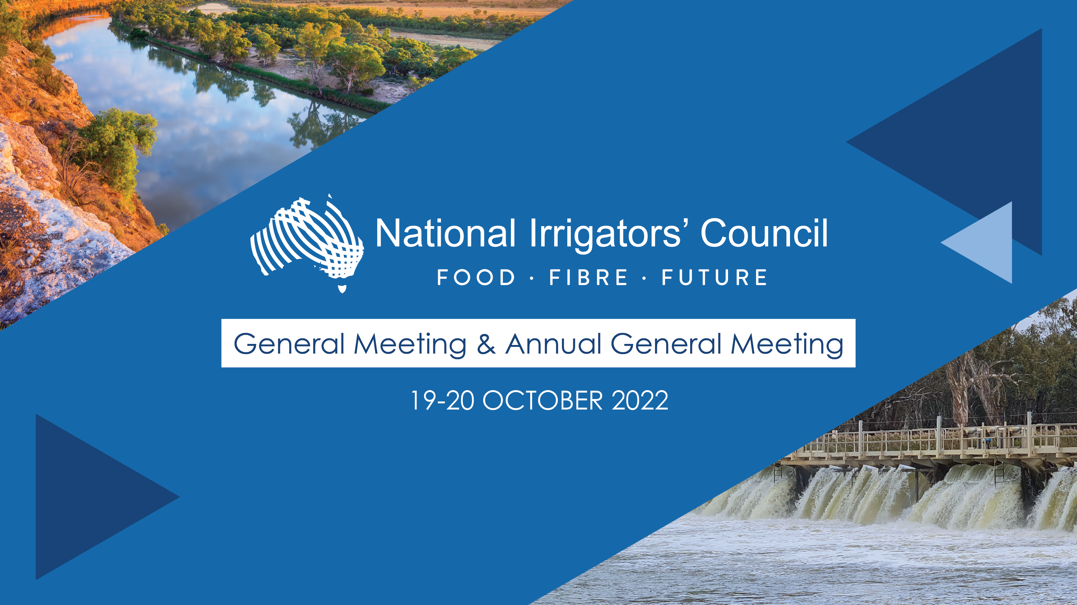

Policy Discussion Workshop
25 February 2026

Slide 2

Today’s Session
Basin Plan Discussion paper – response to queries
General business

Slide 3
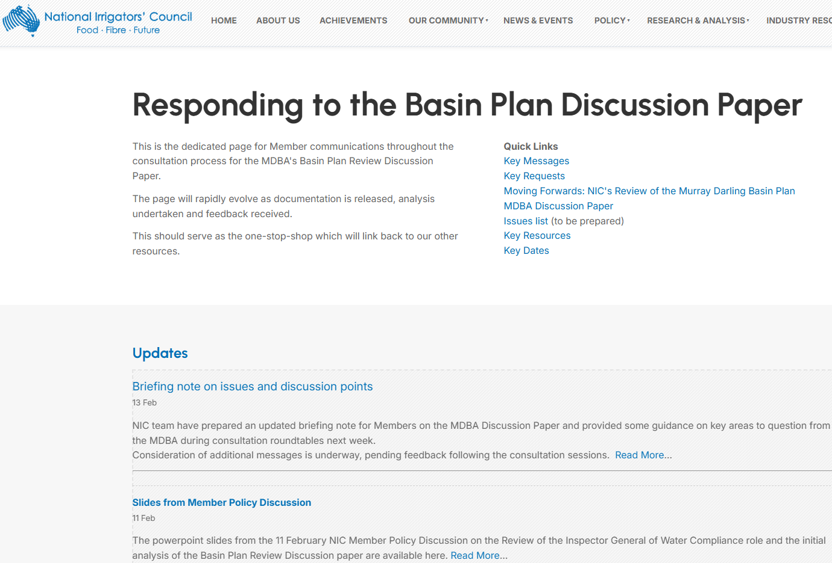
*** are you using our Members Page? ***

Slide 4
What you asked for at our Q&A
Summary of arguments
Key messages
Alternatives to buybacks
Messaging on assumptions
Communities & Ag

Slide 5
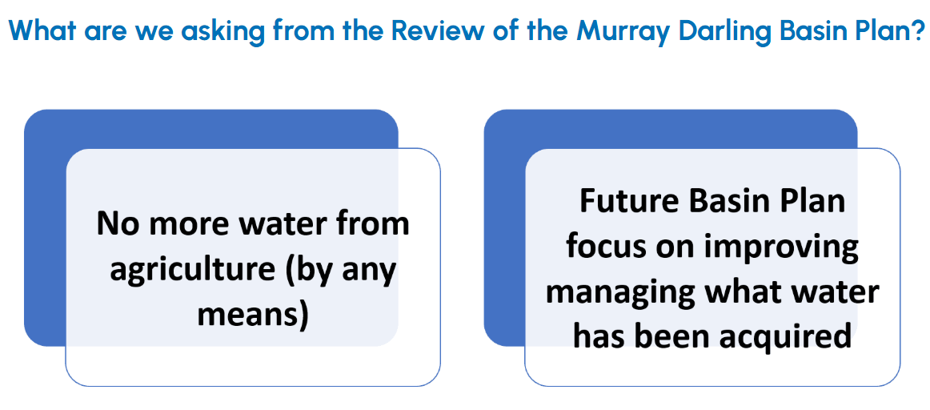
Key messages and requests

Slide 6
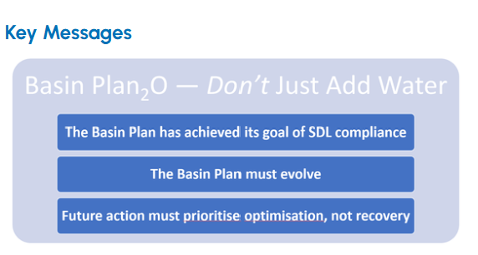
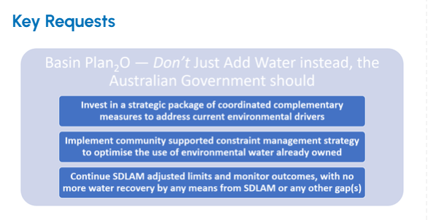
Key messages and requests

Slide 7
Key arguments
PRIORITISATION
Prioritisation will be required on how to achieve the desired outcomes, within funding limitations, and with respect to impacts.
SDLs
The purpose of the Basin Plan was to reduce water diversions to SDLs – this has been achieved.
The initial SDL assessments found most water sources have an SDL = ESLT (either confident or likely) – those ‘undetermined’ with further investigations required, have drivers relating to ‘pattern of flow’ or ‘non-flow’
The evidence suggests moving beyond ‘just add water’ is needed most.
Environment
The data shows the drivers of environmental risks are largely not due to diversion levels. The environment needs more than “just add water”.
We support the approach of looking at the drivers of environmental risks – you need to know the right problem to get the right solution.
Socio-economics
Need to value irrigated agriculture in the Basin, and the role for food/fibre production, national economy, and local communities.
Disagree with the socio-economic assessments undertaken to date, and highlight data gaps.

Slide 8
Messaging on assumptions
The surface water SDL assessments rely most heavily on a “full Basin Plan implementation” scenario (300 GL shortfall recovery, and full 450GL).
The further implementation of Basin Plan 1.0 remains our biggest risk.
Given the findings of the SRA, question the expenditure on the further water recovery of Basin Plan 1.0 given water volumes no longer the key driver (and with large impacts and costs).
Seek the MDBA undertakes an assessment of a “current” scenario, and if SDLs still = ESLT

Slide 9

How do we achieve it (& why)
How do we achieve it (& why)
Logos (logic of the case)Ethos (credibility of the organisation and the case)
Pathos (appealing to emotions to engage audience)
Ethos (credibility of the organisation and the case)
Highlight
Highlight current challenges (non-water based), provide solutions
Moving Forwards Review of the Basin Plan
Example Projects – upcoming drop in
Be
Be collaborative, to remain at the table on a shared journey
Build a coalition of like-minded partners and supporters
Campaign or other ideas
Demonstrate
Demonstrate success of current plan (environment / SDLs)
Moving Forwards Review of the Basin Plan
Use
Use Triple Crown Water Reform Framework to highlight maturation process
AFI Journal Article
OzWater Presentation and Article
Demonstrate
Demonstrate need for optimisation of investment
One Basin CRC Workshop - declaration
Examples projects for ideas – upcoming drop in

Slide 10
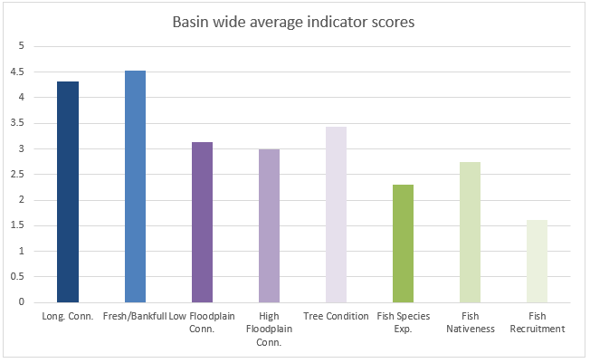
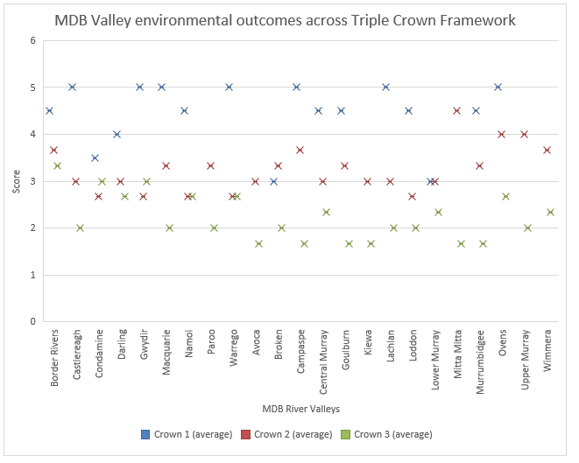
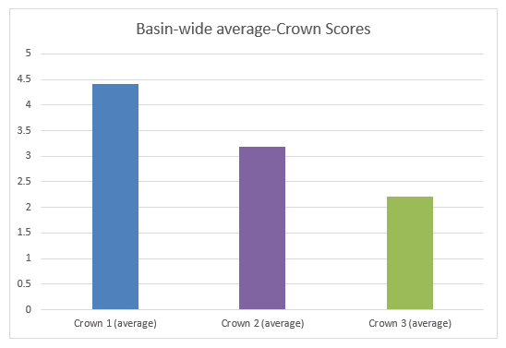
OzWater Paper

Slide 11
Communications & advocacy plan
Internal
Members website
Feedback sessions
Briefs
Draft submission
External NIC
Insta updates
External campaign
To be developed, with support and linked with advocacy planning and implementation for 2027
Fast Facts
Webinar (proposed)
Partner briefings
Newsletter

Slide 12
General business

Slide 13

0427 521 399

Slide 14
Old Slides

Slide 15
Basin Plan Discussion Paper
Discussion Paper
Initial SDL Assessments
SDL Assessment Framework
Menindee Technical Report
Menindee Issues Paper

Slide 16
Basin Plan Discussion Paper
Proposes a shift from water recover (although not entirely ruled out) to addressing other drivers.
Focuses on connectivity – within river (northern basin), onto floodplains (southern basin and the Gwydir) meaning two key focuses is the timing of water deliver and constraints – these largely to address areas of concern with three catchment where they are unsure if the SDL = ESLT.
Does not provide any discussion on challenges for SA Murray and the Coroong, despite the question on ESLT being achieved.
Attempts to consider water quality and critical human needs. However, does not have the current legislative levers.
Makes little suggestions on how to incorporate NRM into Basin Planning.
Makes some reasonable suggestions for streamlining planning and reporting, and WRPs.
Look at Chapter 12 – includes all the proposals and options for Basin Plan 2.0

Slide 17
Basin Plan Discussion Paper Assumptions
The MDBA assessed water sources to determine if water use was a ecological sustainable level of take, they considered three scenarios:
Implementation to June 2024 (retrospective);
Full implementation with the assumption of full 450GL purchased (100 GL from the northern basin) and 300 GL of a SDLAM shortfall recovered but no further constraints (retrospective).
Plausible future climate scenario (forward looking).
Full implementation with the assumption of full 450GL purchased (100 GL from the northern basin) and 300 GL of a SDLAM shortfall recovered
ESLT = Basin Plan + 450GL

Slide 18
Initial SDL Assessment
Three catchments where SDL is unsure – further work is required, however there was no detail on the drivers or discussion for Basin Plan 2.0 for the SA Murray and Coorong.
More catchment are to be monitored, which are the larger ones and two groundwater.
SDL unit | SDL = ESLT | Environmental outcome risks | Drivers
Barwon-Darling | Unable to determine, further work required | Ecosystem function and native fish | Pattern of flow is the likely leading driver of risk
Condamine-Balonne | Confident | Not at risk
Gwydir | Likely | Waterbirds | Pattern of flow
Intersecting Streams | Confident | Not at risk
Lachlan | Confident | Not at risk
Macquarie-Castlereagh | Confident | Not at risk
Murrumbidgee | Likely | Native fish, flows and connectivity, and native vegetation | Pattern of flow

Slide 19
Initial SDL Assessment
Namoi | Confident | Not at risk
NSW Murray | Likely | Flows and connectivity, ecosystem functions and native fish | Pattern of flow
Lower-Darling | Unable to determine, further work required | Flows and connectivity, ecosystem function and native fish | Pattern of flow
SA River Murray | Unable to determine, further work required | Flows and connectivity, ecosystem functions, native fish and waterbird | Pattern of flow (due to constraints) likely, sufficiency of flow also potential factor.
SA Murray Region | Confident | Not at risk
QLD Border Rivers | Confident | Not at risk
Moonie | Confident | Not at risk
Eastern Mount Lofty Ranges | Confident | Not at risk
Marne Saunders | Confident | Not at risk
Warrego | Confident | Not at risk
Nebine | Confident | Not at risk
Paroo | Confident | Not at risk
ACT | Confident | Not at risk
Vic Murray | Likely | Flows and connectivity, ecosystem functions and native fish | Pattern of flow (due to inability to deliver water onto floodplains)

Slide 20
Initial SDL Assessment
Kiewa | Confident | Not at risk
Northern Vic Murray
Ovens | Confident | Not at risk
Broken | Confident | Not at risk
Goulburn | Likely | Flows and connectivity, ecosystem functions and native vegetation | Pattern of flow (inability to deliver higher in-channel flows and water to the floodplain in the lower Goulburn River)
Campaspe | Confident | Not at risk
Loddon | Confident | Not at risk
Wimmera–Mallee | Confident | Not at risk

Slide 21
Gaps
SDL assessment assumptions of recovery and SDLAM.
Of the three catchments where SDL is unsure – further work is required, however there was no detail on the drivers or discussion for Basin Plan 2.0 for the SA Murray and Coorong.
SDL performance (under usage) not discussed, or whether SDL is too low.
No discussion on how to recover water under the assumed scenario, what are the costs and benefits of this versus other options.
Connectivity challenges – mixed messages, between DCCEEW and MDBA, detail with NSW Gov.
Menindee lakes, discussion is a separate consultation although simultaneous.
Lack of regulatory levers for the MDBA at current – no suggestion of changes.
Risk of water from agriculture being used for critical human needs planning.
Infrastructure details and risks.
Alarmingly, there was no discussion the costs and benefits of options and not enough information to inform this as part of the discussion paper – this leads to the key question of priorities.

Slide 22
Next steps & Discussion
Update key messages prior to the Roundtables.
Consider – calling for more information to assess the costs and benefits of options, in lines with Audit Office requirements for regulatory impact assessments – this would help inform prioritisation
Consider – calling for another step on consultation to discuss the benefits of options, once the above is known
Work on infrastructure gaps
Continue to work on prioritisation as part of Oz Water paper
Work on further evidence on SDL has achieved its goal with more explicit evidence of no need for full implementation scenario

Slide 23
Basin Plan Review Strategy – what we are asking for
No more water from agriculture (by any means)
Future Basin Plan focus on improving managing what water has been acquired

